Slide 1
Uncovering the gaming industry’s Hidden gems: A comprehensive analysis of video game sales

Slide 2


Slide 3
Presented by
V. RENUGA
R.HEMALATHA
R.BHARATHI
C. ABIRAMI

Slide 4

Introduction

Slide 5
Market segmentation
The Gaming industry in India Can be categorized Into three segments
Mobile Gaming
Console Gaming
Pc and online gaming

Slide 6
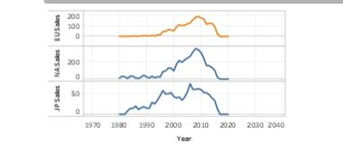
Sales in Europe Japan north America regions

Slide 7
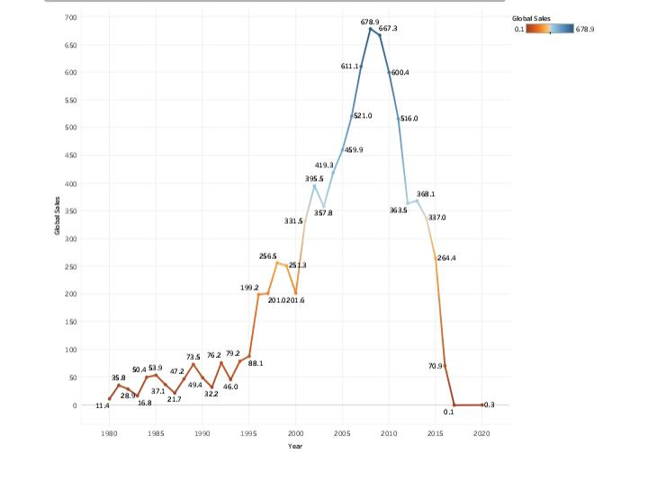
Total sales

Slide 8
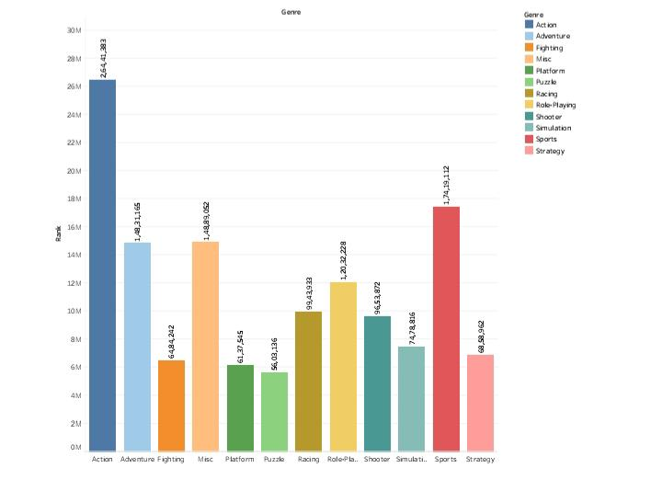
Genre with rank

Slide 9
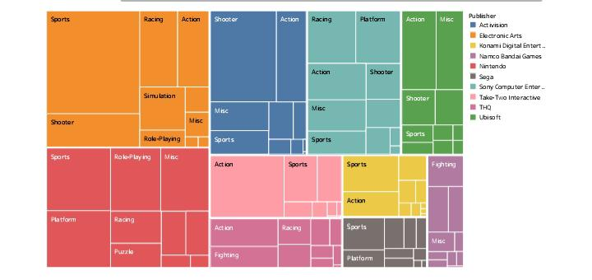
Best 10 Selling genres on platforms

Slide 10
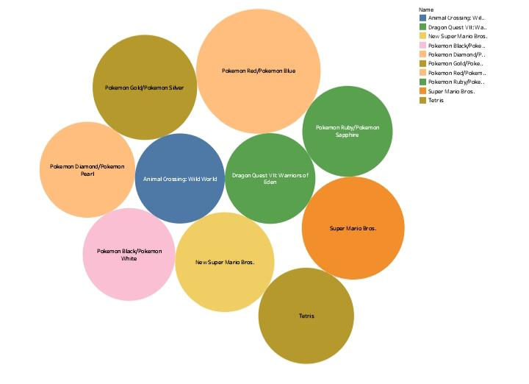
Top 10 Japan selling on vg

Slide 11
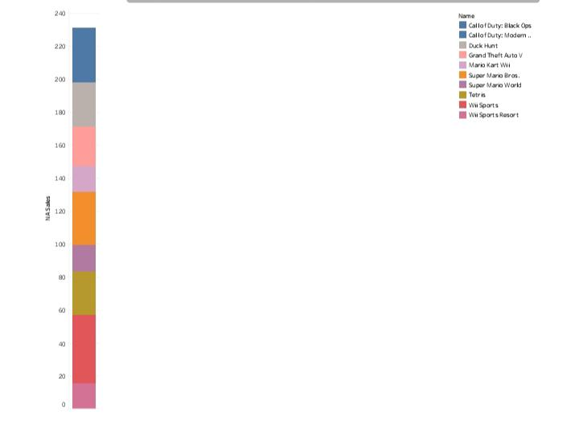
Top 10 north America selling vg

Slide 12
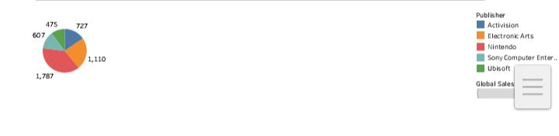
Top 5 publishers

Slide 13
THANK YOU

